Slide 1
Kansas City Public Schools
Educator Evaluation System
2020-2021

Slide 2
Agenda
Introduction
Evaluation Components
Due Dates
Evaluation Process
OASYS

Slide 3
Why is Educator Evaluation Important?
Missouri’s Educator Evaluation System was created, field-tested and piloted, and refined.
Every Student Succeeds Act (ESSA) – Teaching and Learning/Evaluation and Equity
From compliance to effective teaching and continuous improvement.
The primary purpose of the Teacher Evaluation Protocol is to promote growth in effective practice that ultimately increases student performance.
Notes:
We piloted the Missouri Model
We use the Missouri model with a few minor changes
ESSA – Federal govt gave every state the choice to include student growth on evaluations – MO chose to include so we have SGOs

Slide 4
November 13th, 2020
  Pre-Evaluation Review
  Individual Support Plan with baselines established
  Student Growth Objectives
December 18th, 2020
  Two Walkthroughs
March 12th, 2021
Formal Observation/Pre-Observation
Two Walkthroughs
  Individual Support Plan Result due in OASYS
  Student Growth Objectives Results and Rationale due in OASYS
March 26th, 2021
  Summative Evaluation completed in OASYS
Probationary 1st year and Probationary 2nd year (P1 & P2)

Slide 5
November 13th, 2020
  Pre-Evaluation Review
  Individual Support Plan with baselines established
  Student Growth Objectives
December 18th, 2020
  Two Walkthroughs
March 12th, 2021
  Two Walkthroughs
  Individual Support Plan Result due in OASYS
  Student Growth Objectives Results and Rationale due in OASYS
March 26th, 2021
  Summative Evaluation completed in OASYS
Probationary 3rd year, Probationary 4th year, Probationary 5th year
(P3, P4 & P5)

Slide 6
November 13th, 2020
  Pre-Evaluation Review
  Individual Support Plan with baselines established
  Student Growth Objectives
December 18th, 2020
  Two Walkthroughs
April 9th, 2021
  One Walkthrough
  Individual Support Plan Result due in OASYS
  Student Growth Objectives Results and Rationale due in OASYS
April 30th, 2021
  Summative Evaluation completed in OASYS
Tenured 1st year (T1)

Slide 7
November 13th, 2020
  Individual Support Plan
  Student Growth Objectives
December 18th, 2020
  One Walkthrough
April 9th, 2021
  One Walkthrough
  Individual Support Plan Result due in OASYS
  Student Growth Objectives Results & Rationale due in OASYS
Tenured 2nd year and Tenured 3rd year (T2 & T3)

Slide 8
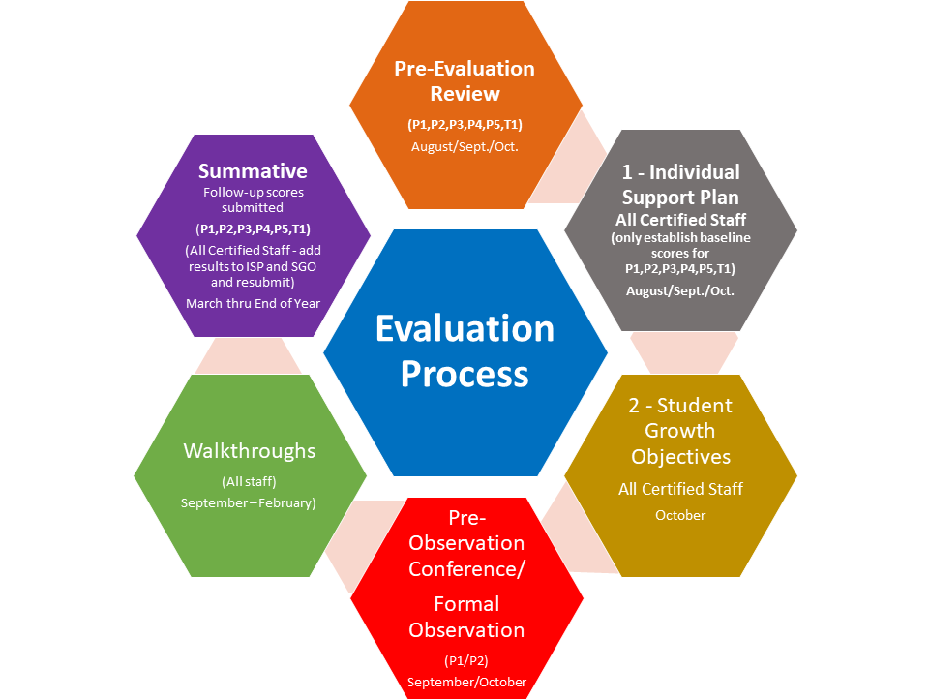
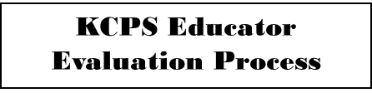
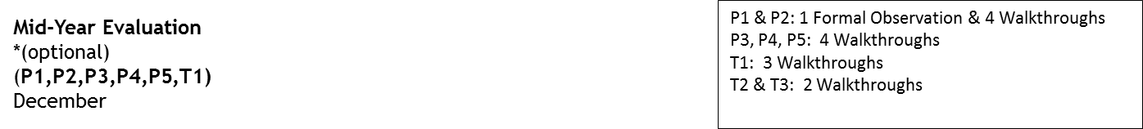

Slide 9
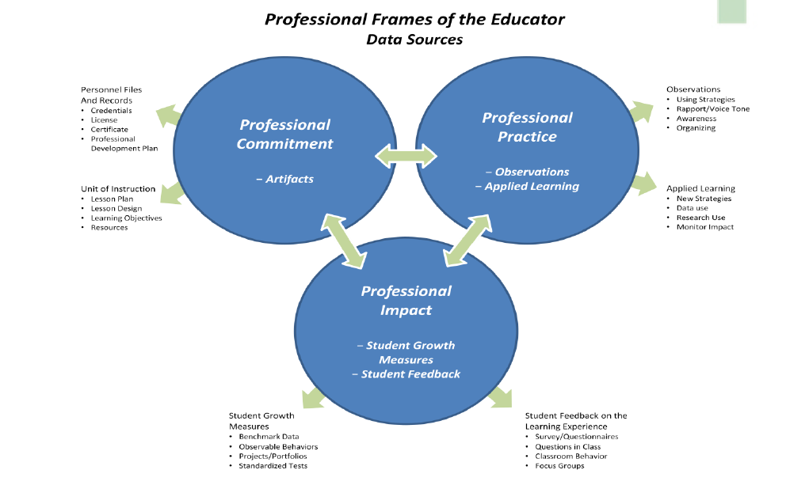

Slide 10
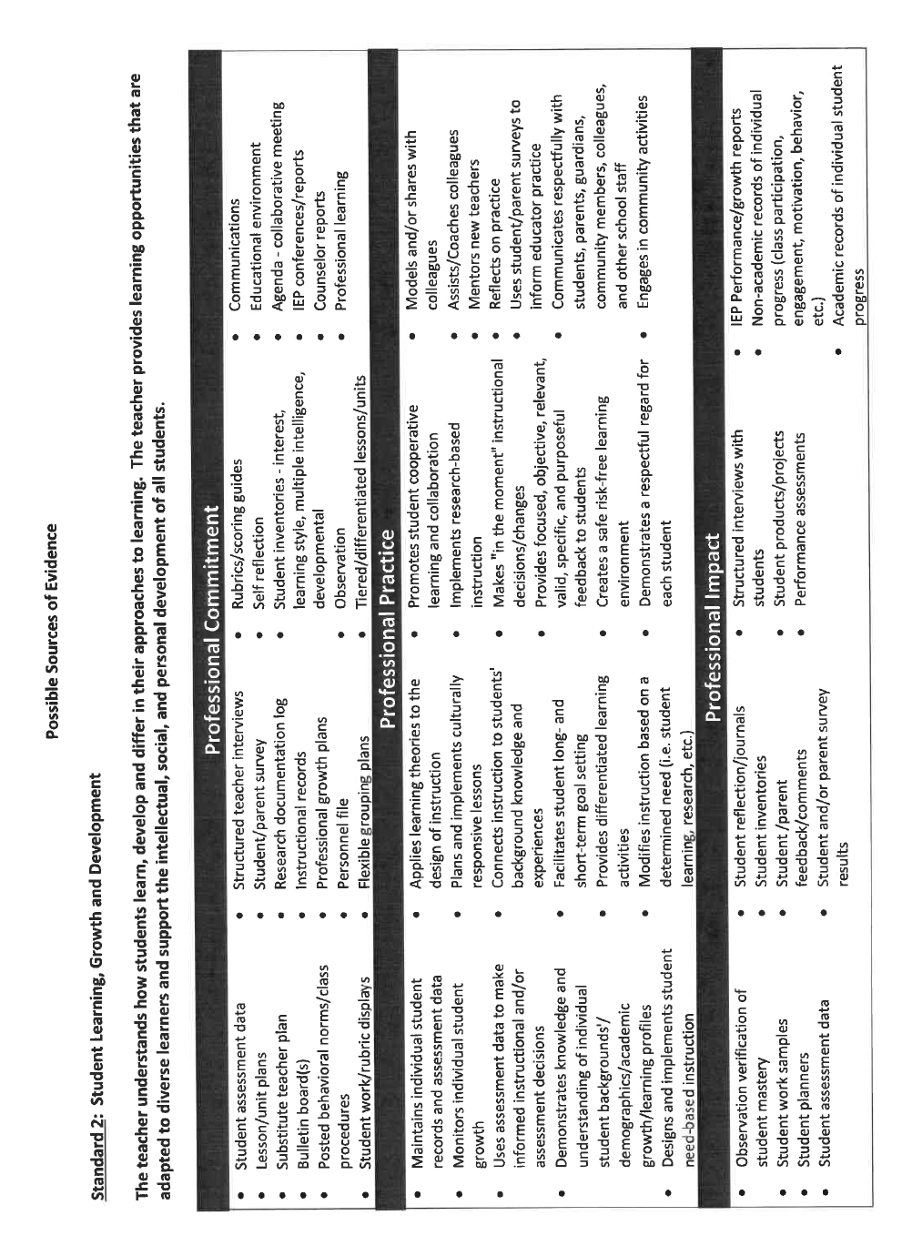
Possible Sources of Evidence – Ex. Standard 2
Notes:
This slides is an example of evidence pieces you would see for Standard 1.
Not a check list, but a rubric for teachers to know what they should be doing to improve and meet the criteria for Standard 1.
Has Possible Sources of Evidence for every Standard

Slide 11
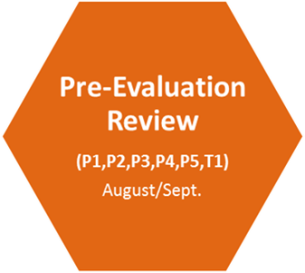
Pre-Evaluation Review
  The evaluator and teacher will conduct an initial assessment together on all standards and indicators.
  Mark each standard on the form:
    Meets Expectation – checking this box for a standard indicates that performance in this area meets the expectation of the administrator/district at the present time.
    Growth Opportunity – checking this box for a standard might possibly result in an indicator from this standard being selected as an opportunity for growth and documented in the Individual Support Plan.
    Area of Concern – checking this box for a standard results in a Professional Growth Plan (PGP) for this standard meaning that growth in this area is both necessary and required for continued employment.
Notes:
This is conducted at the beginning of the year with everyone on an evaluation cycle to review the standards and indicators and mark where they are performing at this time.
Will be marked again with follow up scores on the Summative at the end of the year.

Slide 12
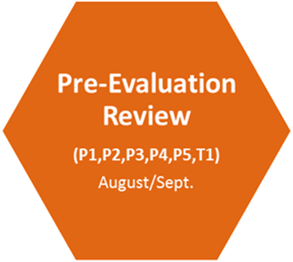
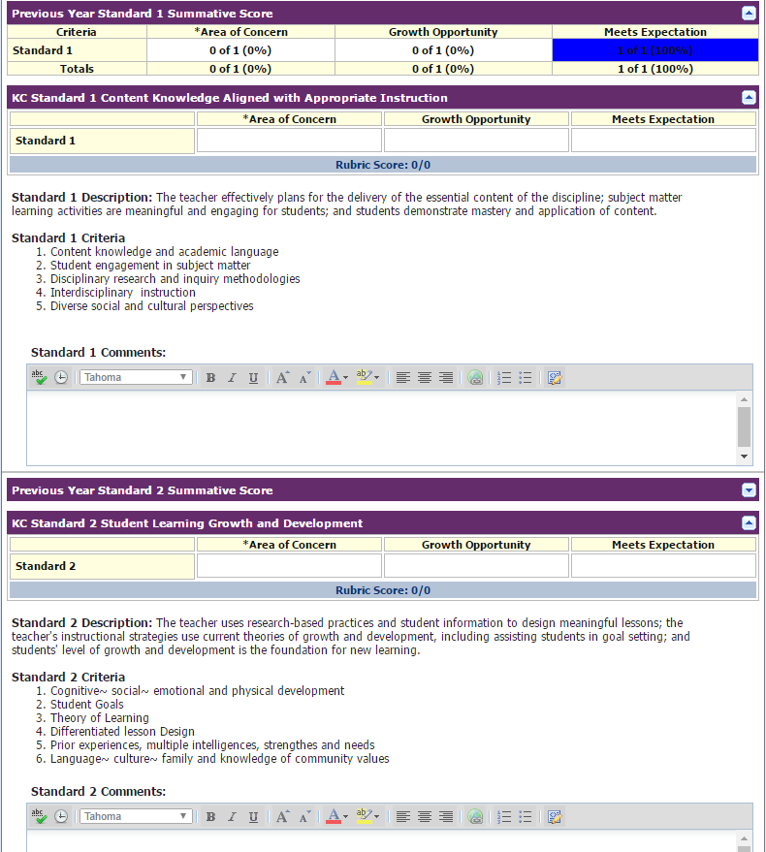
Pre-Evaluation Review Form on OASYS
Notes:
Example of form

Slide 13
  Every certified staff will write one Individual Support Plan (ISP) at the beginning of the year
    ISP
Teachers – Standard 2.4: Student Learning, Growth and Development:
Differentiated Lesson Design
Counselors - 4.4: Leadership and Advocacy: Program Leadership
      Library Media - 6.2: Technology Integration: Knowledge of Technology
      KC Plus Residents /Teaching Methods Coach - 4.1: Data: Knowledge and communication of data analysis
      Resource Teacher - 2.2: Coaching skills, development of a coaching plan
Individual Support Plan
Notes:
Work smarter not harder:
Educators may work together to write their ISPs
If the building has a focus for the year, you can choose a Standard/Indicator to match and teachers CAN (not mandatory nor can you require) work together to write towards this goal for their individual
Use the Marzano, Hattie and Lemov research strategies provided
District ISP MUST be the first one entered in OASYS – it states District Level
Only need to write your goals, etc. on the first page as it will prepopulate to the Results page

Slide 14
Establishing Baseline and Follow up Score
    Baseline score is established at the beginning of the year
    Follow up score is established on the Summative Evaluation
    Scores are determined using Growth Guides and Possible Sources of Evidence
    Scores can be determined by the principal or between the principal and the staff member in a collaborative, professional conversation
Notes:
Baseline & Follow up scores are established for educators on a full evaluation cycle – Not T2 and T3

Slide 15
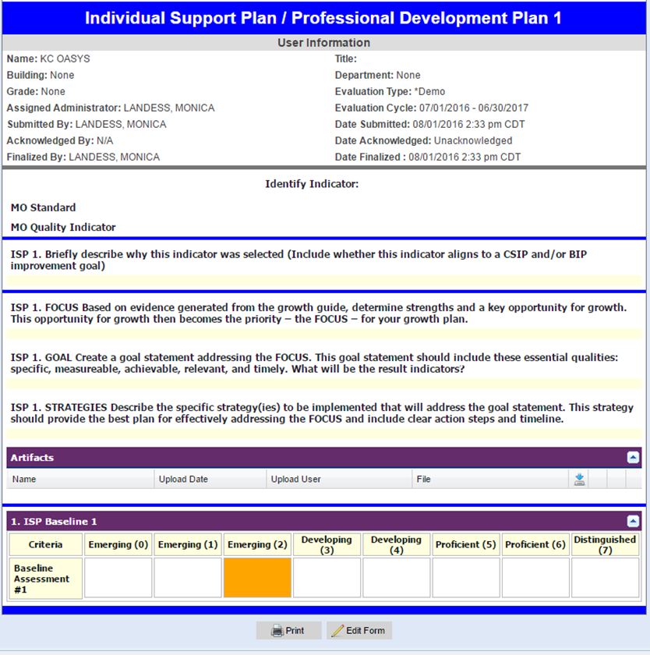
Individual Support Plan
Notes:
Everyone must complete this form by October 13th
Make sure to use this form and not the Results page

Slide 16
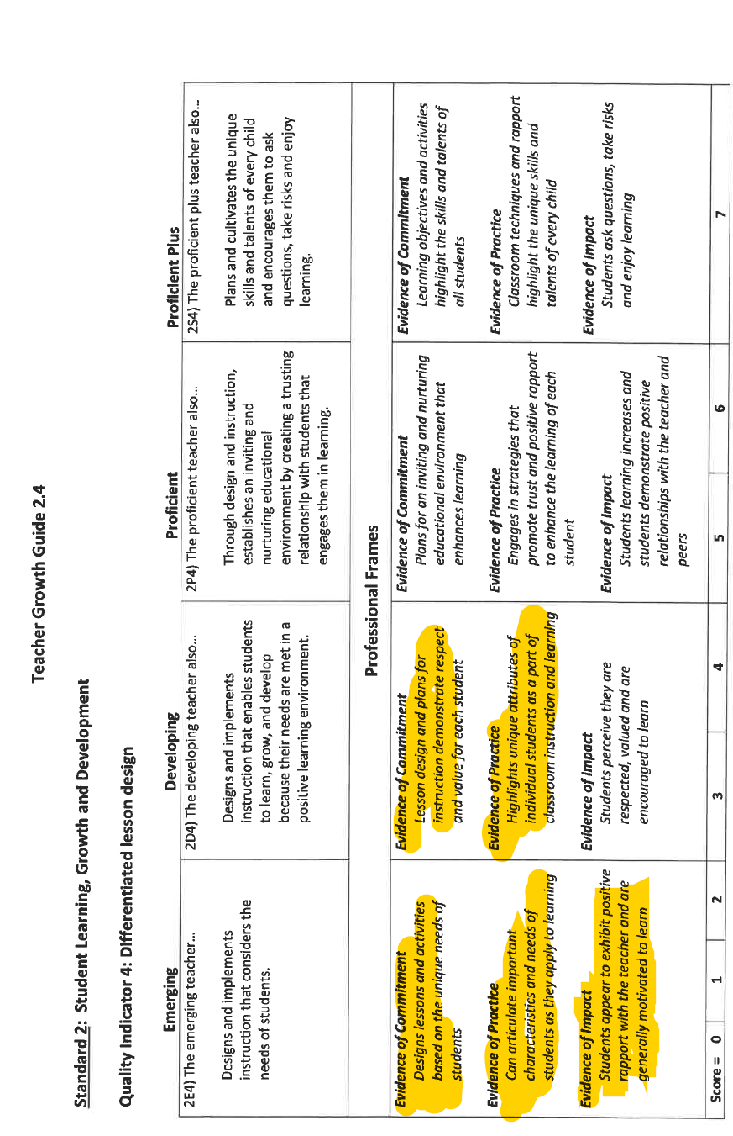
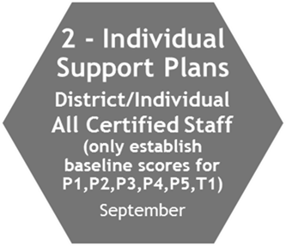
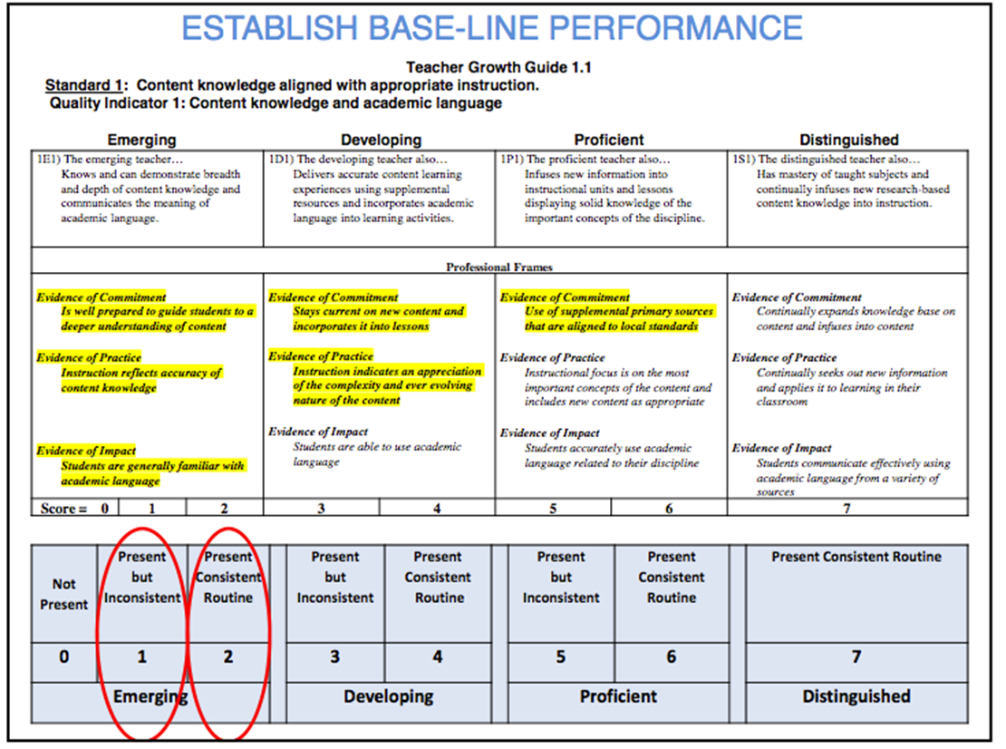
Determining the Baseline
Notes:
Need to have or show all three Evidences to be placed in that category – Commitment, Practice and Impact

Slide 17

Student Growth Objectives
General Information
Two (2) Student Growth Objectives (SGO) using whole class data
Principals must approve Student Growth Objectives
SGO Goals submitted by November 13th, in OASYS
SGO Results submitted in OASYS
  Probationary – March 12th
  Tenured – April 9th
Exclusion Criteria
  Students must have Pre/Post Test data
  Students may be excluded if not in attendance 90% of the time of the SGO
  A teacher may exclude any student he/she is not responsible for the instruction of the SGO content
    Example: Exceptional Ed. pull out, ELL pull out

Slide 18

Student Growth Objective using Benchmark Assessments
CIPD staff created and/or will approve pre and post assessments used for Student Growth Objectives
  Principals will provide teachers with these assessments
  Assessments will align with content specific standards
  Principals will work with teachers that do not have benchmark assessments provided by CIPD to create and/or approve assessments for their student growth objectives
Notes:
CIPD has a booklet they are updating on the assessments and examples of how to write the SGOs
Teachers can reach out to their coordinators for help or with questions regarding the assessments

Slide 19
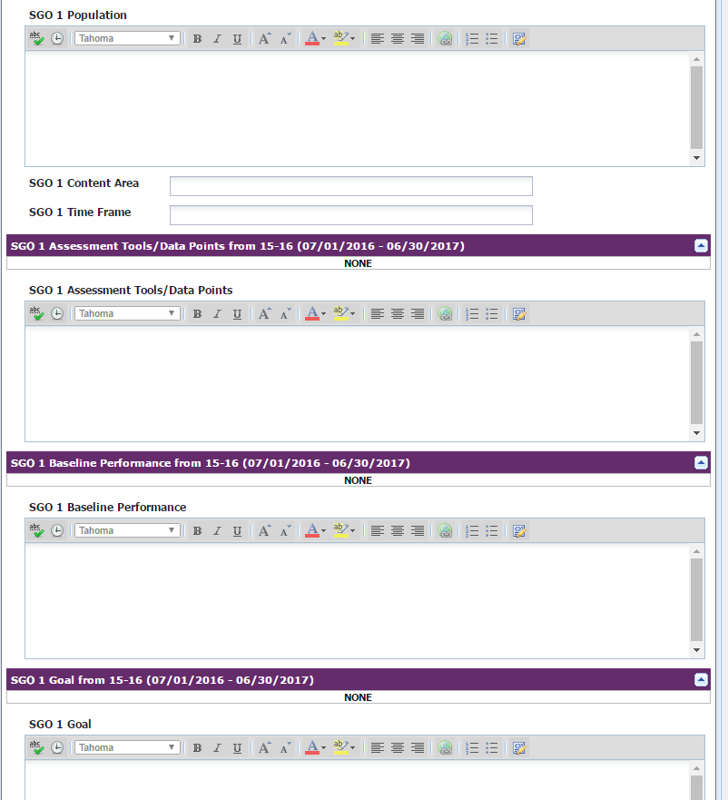
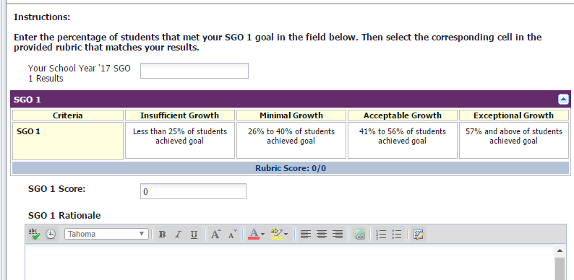
Student Growth Objective Form
Student Growth Objective
Student Growth Objective Results and Rationale
Notes:
Teachers are responsible for completing these forms
Results/Rationale: Teachers must write their percentage and then click the box that matches the %. If they do not click the box, they will not receive a score on their summative.
Artifact required for this form to verify their growth
Rationale required – more than “my students met their goal”

Slide 20
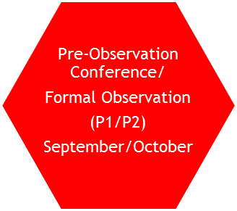
Pre-Observation Conference and Formal Observation (P1, P2)
Principal and teacher determine the time and date of a formal observation.
Teacher completes and submits the Pre-Observation form
Teacher and principal meets to discuss the Pre-Observation form
Principal conducts the formal observation using the Formal Observation form
Formal Observation is a minimum of 30 minutes or a full lesson that is a scheduled observation
After the Formal Observation, principal meets with teacher and provides feedback regarding the formal observation using the Formal Observation form
Notes:
This is for P1 and P2, but can be added for other educators

Slide 21
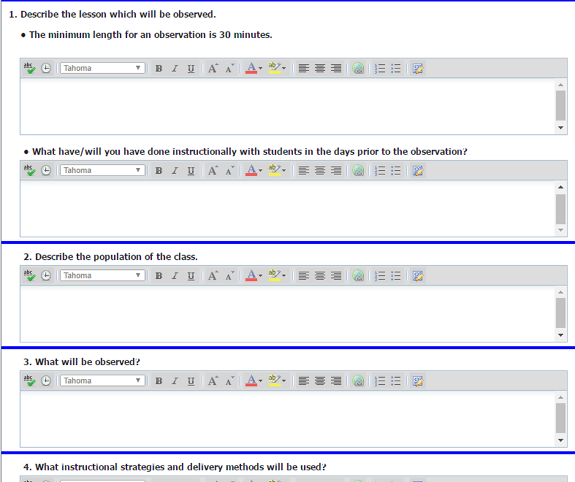
Formal Pre-Observation Conference Form (P1, P2)
Notes:
Example of the form the teacher completes – P1 and P2 only

Slide 22
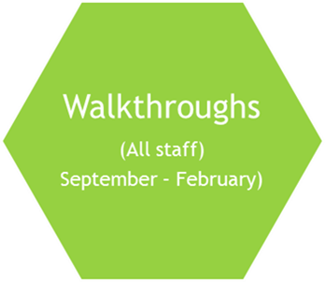
Walkthrough Form
Required Walkthroughs will be conducted and submitted electronically in OASYS throughout the year.
Focus
  Are the objectives and lesson activities based on appropriate Missouri Grade Level standards?
Rigor
  Do the content demands of tasks, questions, texts, and materials align with the expectations defined by Missouri grade-level standards?
Student Understanding
  Do all students demonstrate that they understand the standard/objective?
Level of Practice
  Lagging
  Approaching
  Advancing
  Leading
Feedback will be provided based upon what was observed
The comment box should be used for professional dialogue regarding the lesson
Notes:
Comment Box example: Give feedback and ask a guiding question and ask teacher to reply in Comment Box

Slide 23
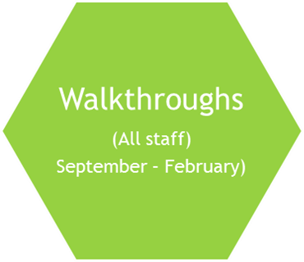
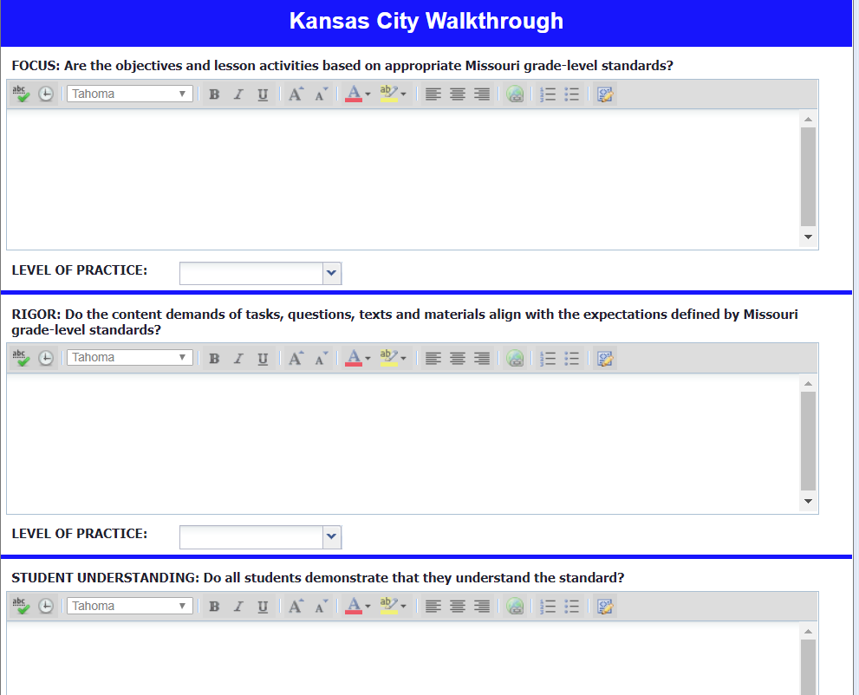
Walkthrough Form

Slide 24
Summative Evaluations
Section One: Standards – 27 points of the evaluation
  Meets Expectation – 3 points
  Growth Opportunity – 2 points
  Area of Concern – 1 point
Section Two: One Individual Support Plan – receive follow-up score
  SY18 = 33 points of the evaluation
Section Three: Two Student Growth Objectives
  #1 SGO = 7.5 points of the evaluation
  #2 SGO = 7.5 points of the evaluation
Final rubric based on a 75 point scale
  Emerging , Developing, Proficient, Proficient Plus

Slide 25
Section 1: Standards
  Meets Expectations = 3 pts.
  Growth Opportunity = 2 pts.
  Area of Concern = 1 pt.
    Total of 27 points possible
Notes:
Marked at the beginning of the year on the Pre-Evaluation Conference Form and marked again for a score on the summative.

Slide 26
Section 2: Individual Support Plan Point Values
Educator ISP – 33 points (2020-2021)
0 | 1 | 2 | 3 | 4 | 5 | 6 | 7
0 pts. | 4.74 pts. | 9.45 pts | 14.16 pts. | 18.87 pts. | 23.58 pts. | 28.29 pts. | 33 pts.
Notes:
Majority of educators in 16/17 achieved a 4 or 5 on both ISPs.

Slide 27
Section 3: Points for each Student Growth Objective
 | SY 20 Growth | SY 20 Points
Exceptional Growth | 57% and above | 7.5 points
Acceptable Growth | 41% to 56% | 5 points
Minimal Growth | 26% to 40% | 2.5 points
Insufficient Growth | Less than 25% | 0 points
Notes:
Reminder – they receive their points based on their Overall RESULTS – not on the results towards their goal.
If they wrote a goal for 80% student growth and only 60% showed growth they would still receive 7.5 pts as they met the goal stated above that the district set. If they wrote a goal for 50% growth and attained 75% - they would receive 7.5 points
Majority of teachers in 16/17 made “Exceptional Growth”

Slide 28
Summative Rating Scale
Proficient Plus | 66-75
Proficient | 53-65
Developing | 31-52
Emerging | 1-30
Notes:
Majority of the educators in 16/17 achieved Proficient status

Slide 29
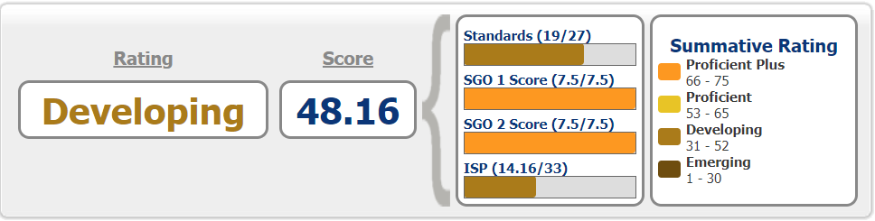
Example of a P2 Overall Teacher Rating on the Summative

Slide 30
My Learning Plan
Login: District email address
Password: First name/Last name Initials + last four (4) of your SSN
Example:
mlandess@kcpublicschools.org
ml4321

Slide 31
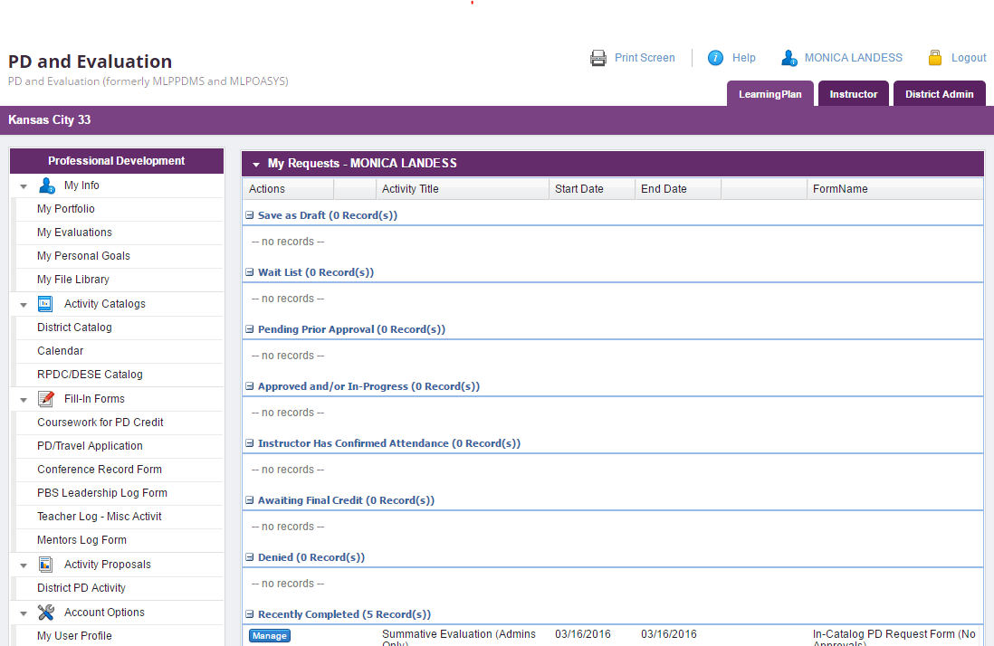
My Learning Plan

Slide 32
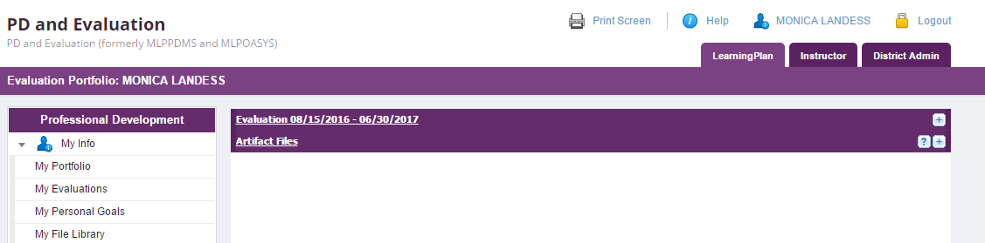
My Learning Plan

Slide 33
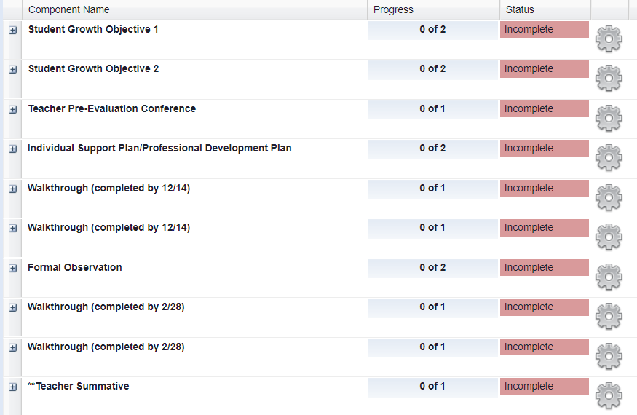
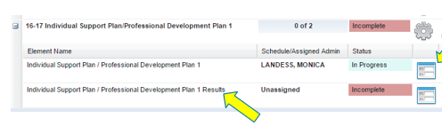
My Learning Plan
Click the + sign
Click the paper form on the right
Notes:
This slides shows them to click on the + to open forms and then where the forms are once they do

Slide 34
Questions or Help
Monica Landess
Talent Acquisition and Evaluation Manager/Human Resources
2901 Troost Ave.
816-418-7276
mlandess@kcpublicschools.org
Becky Nace
Director of Professional Learning/Office of Professional Learning
2901 Troost Ave.
816-418-2684
bnace@kcpublicschools.org

