Slide 1

TESS for Classroom & Specialty Educators
Created for:
Arkansas Career Educators
Created by:
Office of Educator Support/Data
Division of Elementary & Secondary Education
Spring 2020
Notes:
Welcome!
Logistics and schedule for the training (as applies)
Trainer & Participant introductions (If you choose, use a line-up activity – for example, line up by your birth month & birth date before brief introductions or another warm-up activity)
“Today, we will be updating what we know about the Office of Educator Effectiveness – which is now the Office of Educator Support & Development. The website for this office is being updated and now provides information and connection to Teacher Support & Development (Novice teacher mentoring and TESS); Leader Support and Development (Beginning administrator mentoring and LEADS); Professional Learning Opportunities (Arkansas Micro-credentialing); Teacher & Principal Leadership; and National Board (NBCT).”

Slide 2
DESE
Vision for Excellence in Education
Arkansas Department of Education
Agency Strategic Performance Management
Notes:
From kindergarten to post-secondary, every child deserves to be surrounded by a team of excellent educators every year.
Ensuring Equitable Access in Arkansas Schools is part of a larger initiative across the United States designed to move America toward the day when every student in every public school is taught by excellent educators. The Arkansas Department of Education is committed to assisting school districts with finding excellent educators. This process involved attracting high quality candidates to the profession, providing rigorous and relevant preparation, supporting educators to maximize effectiveness and extending opportunities to retain the best teachers.
ADE has begun a new internal process with the purpose of creating focus on the most important contributions to the education of all Arkansas students, as well as organizing and documenting systemic accountability in the work of all those employed by or representing the Department.
This work is the ADE Vision for Excellence in Education and includes elements of a traditional improvement plan.

Slide 3

DESE Vision
The Arkansas Department of Education is transforming Arkansas to lead the nation in student-focused education.
Notes:
The target is easy to see – STUDENT-FOCUSED.
Student-Focused means every student is served in the best way that meets the educational needs of that student. So what does ‘student-focused education’ include?
(Activity of choice, from whole-group response to think-pair-share, may be used to gather information from participants as there are many perspectives which correctly apply. Please use any or all of these suggestions to generate ideas.)
https://en.wikipedia.org/wiki/Student-centred_learning
Q. What is student-focused learning?
A. Using a wide variety of educational programs, learning experiences, instructional approaches, and academic-support strategies that are intended to address the distinct learning needs, interests, aspirations, or cultural backgrounds of individual students and groups of students. Any instructional method that shifts the learning focus from the teacher to the student.
Q. What is a student-focused classroom?
A. A student-centered classroom is built on autonomy and the elimination of traditional teaching practices. The student-centered classroom operates on collaboration, project-based learning, technology integration, and plenty of conversation between students and teachers about learning.
Q. What is a student-focused curriculum?
A. Student-focused Curriculum means students are active participants in their own learning. Teachers are there to provide support and facilitate the student’s learning but students contribute to the direction of their own learning.

Slide 4
DESE Mission
The Arkansas Department of Education provides leadership, support and service to schools, districts, and communities so every student graduates prepared for college, career, and community engagement.
Notes:
This is the mission of ADE.
As you choose, discussions may follow:
Have you heard ‘college- and career-ready’?
What is the role of community engagement in this process?

Slide 5
ADE Values
Leadership
High Standards
Accountability
Support
Service
Whole child
Informed risk-taking
Collaboration
Communication
Effective practices
Professional
Integrity & Honesty
Leverage resources
Notes:
(Here is more information, should you decide this would be useful.)
Leadership
a. Striving to be a model of excellence that is dedicated to professional and ethical standards, the whole child, and effective results.
b. Driving action toward excellence through informed risk-taking.
c. Protecting the public trust by ensuring quality and accountability.
Support
a. Collaborating with others through mutual respect, trust, and professionalism.
b. Communicating in an open, honest, and transparent manner.
c. Fostering new ideas and promoting effective practices.
Service
a. Providing quality service in a respectful, effective, and professional manner.
b. Administering agency programs and services with integrity, honesty, and transparency.
c. Leveraging state resources in an efficient and productive manner.

Slide 6
DESE Goals
Students meet/exceed readiness benchmarks for being prepared – college, career and community,
Students meet/exceed his/her expected growth annually.
Students will develop & apply successful personal competencies for learning, community, and life.
Students will be actively engaged one year after graduation in college, career prep, military service, and/or employment.
ADE will build capacity for customer service by educators to benefit students, taxpayers, and stakeholders.
Notes:
Share this information.

Slide 7
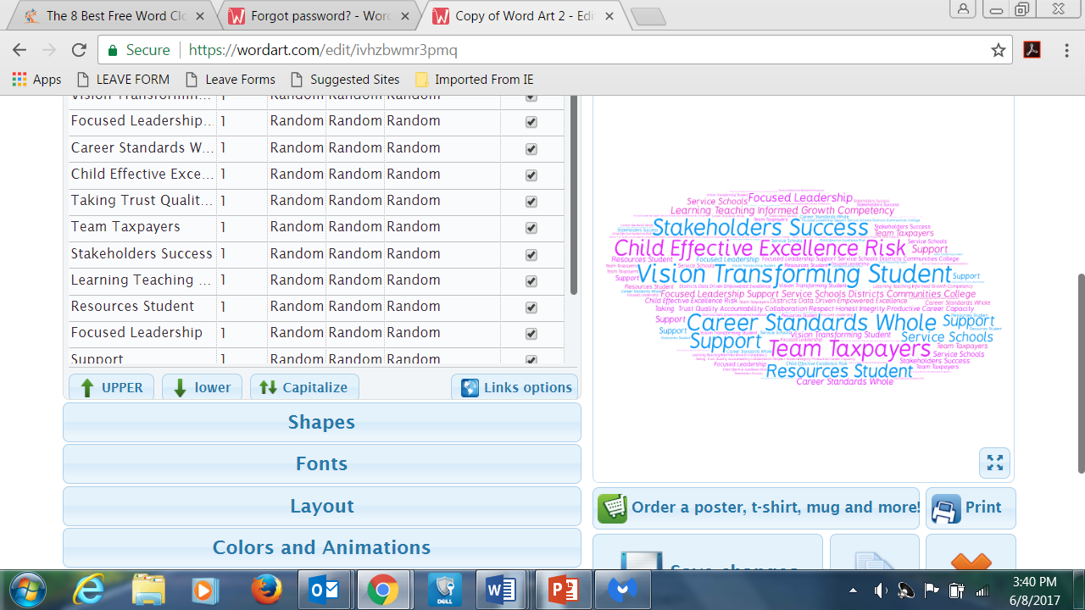
Notes:
We are all familiar with ‘word clouds’ and their many uses. This cloud is made from the vocabulary of the proposed Arkansas Every Student Succeeds Act which should receive approval later this year. As we learn about the content of Arkansas’ ESSA, we will be focusing on the concept of ‘effectiveness’.
Let’s think about Effective Teachers.
(Suggested activity: Group participants as you like and have them create a word cloud with descriptors of an Effective Teacher and present the work to the group.)

Slide 8
Arkansas Every Student Succeeds Act
New ESEA:
In effect Spring 2018
Notes:
ESSA requires that states ensure that poor and minority students are not taught at disproportionate rates by ineffective teachers and requires states to develop a definition for ‘ineffective teacher’. Without a system to support, develop and identify levels of effectiveness, the state will have difficulty meeting the federal requirement. Also, without TESS, there is no legislation to ensure teachers receive support through mentoring or personalized professional development. This legislation also ensures a system of support and development (and quality) for school administrators who are key to ensuring teacher and student success.

Slide 9

Supporting Effective Teachers
Properly plans for all students
Creates the best environment for student learning
Uses the most effective instructional procedures
Communicates &
Collaborates effectively
Continually grows
Notes:
Arkansas ESSA does share the characteristics of effective teachers. If the measure for teacher effectiveness is TESS, which component of the TESS rubric would provide evidence of these practices?
(Format this as best fits your training (e.g. individual responses and explanations, group responses and explanations, using the ‘TESS Smart Card’ posted or copied for participants, referencing the ‘elements’ of components mentioned to further understanding)
- Properly planning for all students.
[Connections for this could be made to any of the components of Domain 1: Planning and Preparation; however, a wider view of planning may be seen through 1e. Designing Coherent Instruction. The elements of this component are Learning activities, Instructional materials and resources, Instructional groups, Lesson and unit structure.]
- Creating the best environment for student learning.
[As in planning, this evidence may be connected to any of the Domain 2: The Classroom Environment components. There is some agreement that two of the Domain 2 components are very strongly tied to this work. First, 2b. Establishing a Culture for Learning with elements: Importance of content; Expectations for learning and achievement; and Student Pride in work. Next, 2c. Managing Classroom Procedures and elements: Instructional groups; Transitions; Materials and supplies; Non-instructional duties; Supervision of volunteer and paraprofessionals.]
- Using the most effective instructional procedures.
[We all recognize Domain 3: Instruction. Instructional procedures are an element of 3a. Communicating with Students. All evidence in this component will provide information about these elements: Expectations for learning; Directions and procedures; Explanations of content; Use of written and oral language. Others may see accountability for effectiveness in component 3d. Using Assessment in Instruction and its elements: Assessment criteria; Monitoring of student learning; Feedback to students; Student self-assessment and monitoring.]
- Communicating & Collaborating effectively.
- Continually growing.
[The final two characteristics are found in Domain 4: Professional Responsibilities. These are clearly connected to the last three components. 4d. Participating in a professional community and elements: Relationships with colleagues; Participation in school projects; Involvement in culture of professional inquiry; Service to school. 4e. Growing and Developing Professionally and elements: Enhancement of content knowledge and pedagogical skill; Receptivity to feedback from colleagues; Service to the profession. 4f. Showing Professionalism and elements: Integrity/ethical conduct; Service to students; Advocacy; Decision-making; Compliance with school/district regulations.]
Simply stated, an ineffective teacher does not demonstrate these practices.

Slide 10
Supporting Effective Leaders
Implements shared leadership with all
Is professionally ethical
Promotes equity & cultural awareness
Support a rigorous curriculum
Communicates & collaborates effectively
Continually grows
Notes:
Taking time for building on the characteristics of effective teachers [previous slide] will benefit all participants as most all participants will be either an Observer or Learner in TESS. However, if administrators are in attendance, you may choose to provide the LEADS Smart Card and design an activity around connections to the LEADS Standards and Functions.

Slide 11

Supporting Effective Instruction
A federal plan focused on supporting & mentoring an effective education work force
Addresses statewide equity gaps:
1) Inexperienced teachers
2) Out-of-field teachers
3) Unqualified teacher
4) Teacher turnover
5) Teacher attrition
  [Equitable Access]
Notes:
Informing the work of Arkansas ESSA, the ADE identified the following equity gaps through data analysis for the Equitable Access to Effective Educators Plan, which is consistent with data from the 2015-2016 school year:
• Students in high poverty and high minority schools are more likely to have an inexperienced teacher than students in low poverty and low minority schools.
• Students in high poverty schools are more likely to have an out-of-field teacher than students in low poverty schools.
• Students in high poverty and high minority schools are more likely to have an unqualified teacher than students in low poverty and low minority schools.
• There is a higher rate of turnover (as measured by the occurrence rate of inexperienced teachers) in high minority schools based on data for the last five years for average number of inexperienced teachers per school per year.
• More recent teacher attrition data show teachers leave HP and HM schools at a higher rate than teachers at LP and LM schools. Teachers at HP and HM schools also leave at a rate greater than the state average, while teachers in LP and LM schools left at a lower rate than the state average.

Slide 12

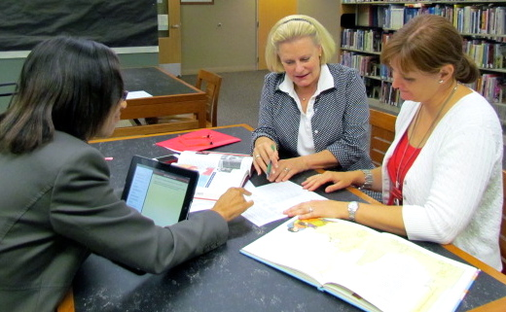
Supporting Effective Instruction
Career Continuum for Teachers
Opportunity Culture Models
Build educator capacity to support each learner:
- Mentoring
- Teacher Quest
- Competency-based learning
- GT Professional Development
Notes:
Please share this information as time allows and as appropriate for participants.
Arkansas needs increased Instructional Capacity for Student-Focused Instruction. Beginning with the 2018-2019 school year, the Department will implement an Educator Career Continuum designed to provide teacher support and development needed to recruit new teachers into the profession and provide opportunities for teachers to grow into new roles for leadership and outstanding achievement as effective teachers without leaving teaching. As an educator moves along the career continuum, the opportunities for professional growth and learning increase, as does the recognition of a high level of accomplishment. Through this work, we will enhance the attraction to teaching and strengthen the educator workforce.
As funding is available, the ADE will seek to use funds to provide training and technical assistance for up to 10 Title I schools to implement the Opportunity Culture model (http://opportunityculture.org/) during the 2018–2019 school year. This new school model provides the structure for schools to take an innovative approach to extend the reach of excellent teachers as LEAs adopt team-based teaching models that extend the reach of excellent teachers to more students, and assume responsibility for those students’ outcomes, pay team leaders more from sustainable sources, and ensure that all teachers have daily support to improve. Opportunity culture schools can take advantage of opportunities to recruit and prepare new teachers with paid residencies and multi-school leader roles for greater impact. New and marginal teachers work with expert master teachers, maximizing talent by encouraging teacher leaders to take on challenging assignments to reach more students, and develop new and marginal teachers to become more effective.
Novice Teacher Mentoring will be overseen by Educational Cooperatives during the 2017-2018 school year. There will be additional support provided focused on identified needs of beginning educators which will provide unique learning opportunities.
There will be a Novice Teacher Quest following the format of the new ADE Leadership Quest begun last year.
Student-focused learning is for ALL students- and for the first time ever, we are guided to provide the best possible environment for learners who have exceptional skills in one or more area – through new Gifted and Talented Professional Development.
The challenges are exciting and encouraging our best effort in our work for the sake of all Arkansas students!

Slide 13
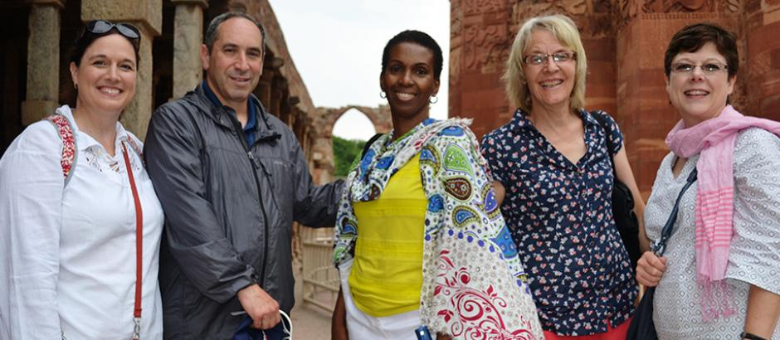
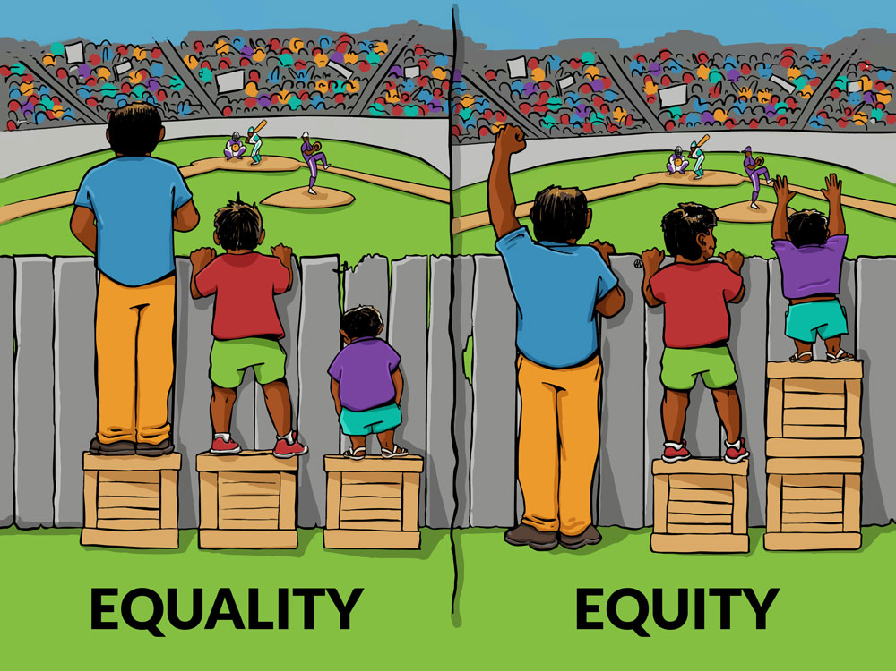
Supporting Effective Instruction
Equity Labs
Grow-Your-Own-Educators
- Paraprofessionals
- Teacher Cadets
- Teacher Residency
Notes:
Please share this information as time allows and as appropriate for participants.
To promote communication and collaboration to ensure that all students have equitable access to effective teachers and leaders, the ADE will work within its 15 educational service cooperatives and support structures within Pulaski County to establish equity labs. Equity labs will provide a structure for regional meetings to support implementation planning and provide opportunities for stakeholders to:
Discuss approaches to ensuring equitable access to effective educators;
Develop communities of practice to explore common implementation challenges and share best practices on data use and analysis, rural access issues, stakeholder engagement, and policies and programs;
Identify tools and resources to support implementation planning, ongoing stakeholder engagement and communication, supporting local educational agencies (LEAs) in implementing local strategies, and monitoring and reporting progress; and
Share state specific support available to address equity gaps.
As the state has examined its educator workforce needs, stakeholders are realizing the importance of “Grow Your Own” initiatives to cultivate local talent and create pathways to the educator profession with early career experience and extending support through college into the workforce. Arkansas’s districts have expanded the Teacher Cadet program to more than 38 districts with participating high schools for the 2017–2018 school year with more than 450 students involved. Next year, an additional 21 schools will participate with an expected additional 250 students. The state has recently partnered with Educators Rising (https://www.educatorsrising.org/) to provide high school students with hands-on Arkansas State ESSA Plan Draft Published: May 22, 2017 85 teaching experience, sustain their interest in the profession, and help them cultivate the skills they need to be successful educators. Partnering with the state’s institutions of higher education educator preparation programs, Educators Rising will be the umbrella for all recruitment initiatives, providing resources through a strong network of supports, with the goal of growing the next generation of teacher. Teachers who have a higher degree of cultural competency are more likely to remain in the school.

Slide 14

Need more information?
Please learn more about the Equitable Access to Effective Educators Plan and the Arkansas Every Student Succeeds Act on the Arkansas Department of Education website, or contact DESE.
Notes:
www.Arkansased.gov

Slide 15
Brain-Break:
Numbered Heads Together
1. Teacher Leadership is a topic we have discussed for quite a while in education. Is this a good time for Teacher Leadership? What are the new and different challenges affecting teacher leadership in schools today?
Notes:
From KaganOnline.com:
Numbered Heads Together
[Standing for this is a good physical change for participants who have been sitting.]
GROUP participants (number off or all self-grouping).
Present the question – ALLOW think time.
Groups put HEADS TOGETHER and SHARE.
Have 1 person from each group REPORT from the group discussion.
Next Step: Move on or allow brief whole group discussion.
Possible topics may arise: New Curriculums, New Assessments, Teacher evaluation controversies, tightening finances, Reform agendas from those outside the school system

Slide 16
Brain-Break:
Numbered Heads Together
2. Education reformers have ideas about strategies for success. One is that teachers and students must teach and learn in an environment that empowers them to do their best. What does this mean?
Notes:
Continue Numbered Heads Together procedure.

Slide 17
Brain-Break: One More –
Numbered Heads Together
3. Teams of teachers across the United States are coming up with great ideas to improve their schools – and even more teachers could do so. What should be done to get more practicing, experienced teachers to solve problems in education?
Notes:
Continue Numbered Heads Together procedure.
To summarize this activity you might want to share or ask participants to share positive experiences with teachers solving problems in classrooms and schools.
Thoughts on Teacher Leadership used for this Brain-Break are from:
Educational Leadership, October 2013/Volume 71/Number 2
Leveraging Teacher Leadership

Slide 18
ACT 295 of 2017: TESS & LEADS – even better!
State systems for
Educator Observations & Ratings

Slide 19
TESS Statute
(as amended by Act 295)
FOCUS of TESS continues:
Effective teaching practice
Impact of quality teaching on positive student outcomes
Continuous improvement
Embedded student growth
Summative evaluation at least once every 4 years
PGP is the system driver
Teacher Fair Dismissal not changed or negated
Notes:
The revisions to the TESS statute promote:
Greater flexibility and local decision-making
Self-advocacy
Connecting professional growth outcomes to personized and competency-based professional learning opportunities.

Slide 20
TESS Statute
(as amended by Act 295)
‘Formative’ Years:
Support
Professional Growth via Competency-based
Learning format: collaboration, self-directed research, or micro-credentialing
State requires Summative Annual Rating, but not in Formative Years
Notes:
“Formative” years are for support and professional growth through
personalized, competency-based professional learning opportunities
that aligns to the professional growth plan
• Allows for professional learning through team collaboration, self-directed
research, or competency-based credentialing
• No overall annual rating required in interim years

Slide 21
TESS Statute
(as amended by Act 295)
Now discretionary, not state-directed:
Definition of artifacts
Number and format for Formal/Informal Observations
Pre-and Post-Observation Conferences
Amount of Observation Time
Annual evidence of Student Growth
Amount of Professional Development tied to PGP
Notes:
• Permissive language allows for more flexibility in the number and naming of performance ratings for possible future rubric changes. Allows for different ratings for novice teachers that are more affirming ratings as the teachers progress in their growth.
• No domain level ratings, but instead one overall rating.
• Uses multiple measures as evidence of teacher’s practice: direct observation, indirect observation, artifacts, data
• All evidence contributes to ONE overall summative rating (student growth is demonstrated through multiple measures using artifacts and evidence embedded throughout the domains; is not just one component)
• School district, teachers determine what constitutes artifacts and other evidence
• May use NBCT work, peer observations, student surveys as part of evidence.

Slide 22
Novice & Probationary
Summative Evaluations
Novice teachers are not required to have a summative rating by the Division of Elementary & Secondary Education; they will have mentoring and support instead.
DESE does not require Summative Evaluations for probationary. Probationary teachers follow the four-year cycle, or district policy.
Districts/charters may choose to conduct summative evaluations.
These educators may be placed in intensive support status if necessary.
Notes:
To clarify: ADE does not require Novice and Probationary Teachers to have an overall annual performance rating, but a school/district policy may choose to require summative work.

Slide 23


“Every morning in Africa, a Gazelle wakes up. It knows it must run faster than the fastest lion or it will be killed.
Every morning a Lion wakes up. It knows it must outrun the slowest Gazelle or it will starve to death.
Notes:
This and the next slide make the point that every educator participating in TESS is responsible for documentation of instructional implementation and has tools for communication and advocacy of professional practice in EdReflect. EdReflect functions remain the same for the 2017-2018 school year – even though state requirements for the work may have changed.

Slide 24


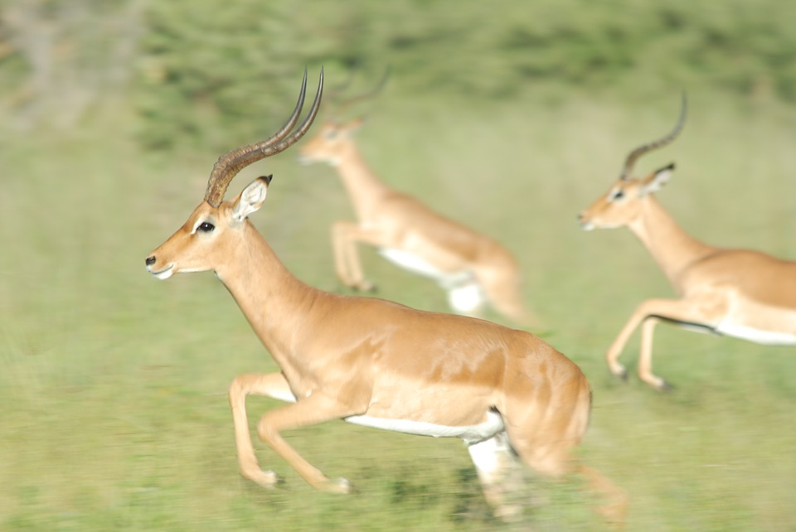
It doesn’t matter whether you are a Lion or a Gazelle. . . When the sun comes up, you’d better be running.”
― Christopher McDougall, Born to Run: A Hidden Tribe, Superathletes, and the Greatest Race the World Has Never Seen
Notes:
Please share that TESS in EdReflect provides classroom and specialty educators opportunities to contribute to the documentation of their work. If a situation arises which calls for a clarification of something seen, heard, or noted by an observer, it is wise to provide that information in the system used for ratings, EdReflect. When involved in advocacy, remember some things (next slide).

Slide 25

TESS Advocacy for Observers & Learners
Professional Attitudes
Careful, Clear Communication
Appropriate Documentation
Working knowledge of system resources
Notes:
You may choose to allow time for discussion of an experience in self-advocacy by participants.

Slide 26
WOWs & WONDERS
Share the understandings you gained from our time together today.
What did you have confirmed for you?
What was new to you?
What pertinent questions does this bring up?
What does this mean for you in the classroom?
What could have been done to deepen improve this training?
Notes:
Please use this wrap-up to your benefit! Thanks for all you are doing!

Slide 27
Educator Support/Data Unit
Dr. Frank Servedio, Leader
Frank.Servedio@Arkansas.gov
Becky Gibson, TESS, LEADS, & EdReflect Advisor
Becky.Gibson@Arkansas.gov
Renee Nelson, National Board Certification Advisor Renee.Nelson@Arkansas.gov
Mike Vincent, Educator Data & Opportunity Culture Advisor Mike.Vincent@Arkansas.gov
Notes:
“These are the contacts for Educator Support & Data. If you have questions or problems and need assistance, please contact them.”

