Slide 1
Teacher Evaluation
New Teacher Orientation
August 15, 2013

Slide 2
Outcomes
Teachers will gain an understanding of Baltimore County Public School’s Teacher Evaluation System

Slide 3
Evaluation Outcomes
In discussing a new evaluation system, committees focused on…
Creating an evaluation that is consistent, fair and equitable (all speaking the same language)
Creating an evaluation that allows for teacher growth
Creating an evaluation that enhances student achievement, while at the same time, allows for professional growth

Slide 4
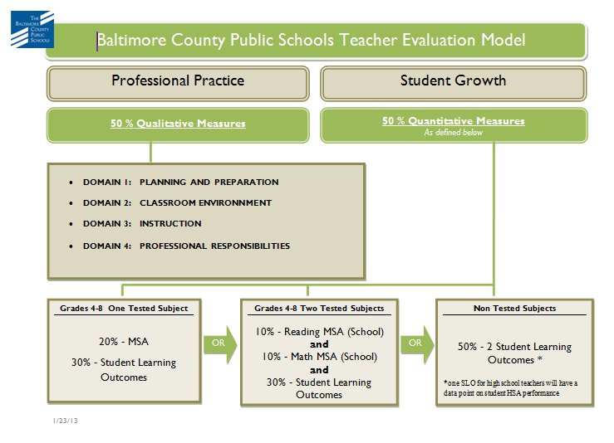

Slide 5
Overview of Evaluation Model
50 % Qualitative Measures: Charlotte Danielson Framework
50 % Quantitative Measures: SLO’s and Test Data
Overall Possible Evaluation Ratings
Highly Effective (distinguished and “student led”)
Effective
Effective Developing
Ineffective
*Highly Effective, Effective and Effective Developing are all seen as Satisfactory.

Slide 6
Evaluation Model cont…
3 year cycle (Formative, Formative, Summative)
2 Formative Years
1 Summative Year
-Formal (4) and informal observation data
-Professional Growth Plan evidence
-Student Learning Outcome evidence
*NON TENURED TEACHERS- Every year until tenure is a Summative Year

Slide 7
Why Danielson?
Comprehensive description of what teachers “do”
Based on a large body of educational research
There’s no “gotcha factor”
Allows for all types of teaching situations
Provides a common language among professionals
Creates a forum for discussion about teaching
Encourages teacher self-reflection and evaluation
Versatility for all levels of expertise and experience

Slide 8
Qualitative Measures The Danielson Model
Planning and Preparation
Domain 1
Classroom Environment
Domain 2
Instruction
Domain 3
Professional Responsibilities
Domain 4

Slide 9
Qualitative Measures The Framework for Teaching
Domain 1: Planning and Preparation
Domain 2: Classroom Management
Domain 3: Instruction
Domain 4: Professional Responsibilities

Slide 10
The Domains
An Overview
Allows for consistent, deep and professional conversations between principals and teachers.
Domains 1 and 4 are the “behind the scenes” work (off stage)
Domains 2 and 3 are observable (on stage)
Help teachers to become more thoughtful practitioners

Slide 11
Domain 1 Planning and Preparation
Components:
1a: Demonstrating Knowledge of Content and Pedagogy
1b: Demonstrating Knowledge of Students
1c: Setting Instructional Outcomes
1d: Designing Learning Activities
1e: Designing Student Assessments
*This is showing what you know and what you do with that knowledge!!

Slide 12
Domain 1 includes…
Knowledge of Content, Students and the Learning Process
Knowledge of Students’ Interests and Cultural Heritage
Knowledge of Students’ Special Needs
Differentiation is planned
Design of Formative Assessments
Management of groups
Learning Activities
Instructional materials/resources
Instructional groups
Lesson and unit structure

Slide 13
Domain 2 Classroom Environment
Components:
2a: Creating and Environment of Respect and Rapport
2b: Establishing a Culture for Learning
2c: Managing Classroom Procedures
2d: Managing Student Behavior
2e: Arrangement of Physical Space

Slide 14
Domain 2 includes…
Teacher interaction with students
Expectations for learning and achievement
Student pride in work
Management of instructional groups/transitions
Management of materials and supplies
Monitoring student behavior
Response to student misbehavior
Safety and Accessibility

Slide 15
Domain 3 Instruction
Components:
3a: Communicating with Students
3b: Using Questioning and Discussion Techniques
3c: Engaging Students in Learning
3d: Using Assessments in Instruction

Slide 16
Domain 3 includes…
Expectations for learning and explanations of content
Directions and procedures
Quality of questions and discussion techniques
Activities and assignments
Grouping of students
Structure and pacing
Feedback to students and monitoring of student learning
Assessment criteria
Lesson Adjustment, Flexibility and Responsiveness

Slide 17
Domain 4 Professional Responsibilities
Components:
4a: Reflecting on Teaching
4b: Maintaining Accurate Records
4c: Communicating with Families
4d: Participating in a Professional Community
4e: Growing and Developing Professionally
4f: Showing Professionalism
*The components of Domain 4…encompass the roles assumed outside of and in addition to those in the classroom with students.

Slide 18
What About Domain 4???
Best demonstrated through “stuff” that you typically don’t see from observation directly
“Stuff” might include:
-Class newsletters
-Phone log
-Letters to parents about a new program
-Involvement in school programming
-Documents from Professional development
Can gather evidence through interview, artifacts, and teacher’s self reflection

Slide 19
Let’s break for… Questions???

Slide 20
Quantitative Measures
Percentage varies by teaching assignment
State Testing Data
Student Learning Outcomes

Slide 21
Evaluation Criteria
Non-Tested Subjects
50% Qualitative Measures
Charlotte Danielson Framework
Domains 1-4
50 % Quantitative Measures
50% SLOs
Grade 4 - 8
One Tested Subject
50% Qualitative Measures
Charlotte Danielson Framework
Domains 1-4
50 % Quantitative Measures
30% SLOs
20% MSA Data
Grade 4 - 8
Two Tested Subjects
50% Qualitative Measures
Charlotte Danielson Framework
Domains 1-4
50 % Quantitative Measures
30% SLOs
10% MSA Math Data
10% MSA Reading Data

Slide 22
Student Learning Outcomes (SLO’s)
Measure student growth by establishing formal learning goals.
Applies to all teaching assignments.
Can be adapted to measure individual, group, or school performance.

Slide 23
Essential Components of SLO’s
1. Statement of Outcome
2. Rationale
3. Student Population
4. Interval of Instruction
5. Target(s) and Evidence
6. Rationale for Targets

Slide 24
Statement of Outcome
The statement of the outcome should represent the enduring learning and/or the most important skill development expected of the students during the course

Slide 25
Rationale
Explains why you chose this outcome and why it is an appropriate area of focus.
Teachers should consider federal, state and system standards as well as system expectations for students in the course.

Slide 26
Student Population
Identify which students the outcome addresses and from which classes.
For most outcomes it should be all students in a class but there may be times a subgroup of students is an appropriate choice.

Slide 27
Interval of Instruction
Typically one year or one semester
School Year 2013-2014 can be based on a unit’s time

Slide 28
Targets and Evidence
Where will this population of students be at the end of the interval of instruction?
May reflect progress of mastery of the outcome in percentages or numbers.
Targets may be tiered to reflect differentiation among students.
At least one source of evidence is required, but multiple sources may be used.
If a common assessment exists, it should be considered as a primary source of evidence.
Evidence may include pre-test and post-tests, projects and portfolios or other student work samples measured across time.

Slide 29
Rationale for Target
Identifies how the target was chosen
How was this determined to be a rigorous target.
Pre-test or baseline information that informed the decision should also be identified.

Slide 30
Principal’s Role
Ensure quality of the SLOs
Review and approve teacher SLOs
Develop school wide SLOs that are included in the principal’s goals

Slide 31
Teacher Guidelines
Align 1 SLO to Principal’s goals
Review models of SLOs from Staff Relations Intranet site for ideas
Create SLO by grade level or content teams

Slide 32
Teacher Guidelines cont..
Derive measures from current curriculum resources, if appropriate
Create an appropriate assessment if none is available in the curriculum
Format SLO according to the template provided

Slide 33
SLO Resources
Rubrics to assess SLO rigor
Guidance documents on creating SLOs (intranet)
C & I examples of SLOs (intranet)

Slide 34
SLO Timeline
Before November 15, 2012
Teacher reviews student data and drafts one of more SLO.
Evaluator reviews and approves outcome and targets.
Mid Unit
Evaluator and teacher review and assess progress toward targets.
End of Unit
Evaluator and teacher review and assess progress toward targets.
Evaluator assigns score.

Slide 35
SLO Rubric
Rating | Criteria
4 | At least 85 percent of the student population exceeded the target.
3 | 70-84 percent of the student population met or exceeded the target.
2 | 60-69 percent of the student population met or exceeded the target.
1 | Less than 60 percent of the student population met or exceeded the target.

Slide 36
Questions?

