Slide 1

Instructional Personnel Performance Appraisal System
2020-2021

Slide 2
Did you know . . . ?
Teacher and administrator evaluations are governed by Florida Statute 1012.34 and State Board Rule 6A 5.065
The Florida Department of Education and the Brevard School Board must approve educator evaluation systems annually
The IPPAS Project Team, comprised of teachers, Union leaders, district and school-based administrators, annually reviews and recommends revisions to the system

Slide 3
Did you know . . . ?
Teacher evaluation systems must
  Be designed to support effective instruction and student learning growth
  Provide for continuous quality improvement of educators’ professional skills
  Include performance data from multiple sources
  Differentiate among four levels of performance (highly effective, effective, needs improvement, unsatisfactory)
  Include data and indicators of student learning growth (FL St 1012.34)

Slide 4
Did you know . . . ?
Teacher evaluation criteria must include indicators based upon each of the Florida Educator Accomplished Practices (FEAPs)
  Quality of Instruction:
    Instructional Design and Lesson Planning
    The Learning Environment
    Instructional Delivery and Facilitation
    Assessment
    (State Board Rule 6A 5.065)

Slide 5
Did you know . . . ?
  Continuous Professional Improvement
    Designs purposeful professional goals to strengthen effectiveness of instruction
    Uses data-informed research to improve instruction and student achievement
    Uses a variety of data used independently and in collaboration with colleagues to evaluate learning outcomes, adjust planning, and continuously improve effectiveness of lessons
    (State Board Rule 6A 5.065)

Slide 6
Did you know . . . ?
  Professional Responsibility and Ethical Conduct
    Collaborates with home, school, and larger community to support student learning and continuous improvement
    Engages in targeted professional growth opportunities and reflective practices
    Implements knowledge and skills learned in professional development in teaching
    Adheres to the Code of Ethics and the Principles of Professional Conduct of the Education Profession of Florida
    (State Board Rule 6A 5.065)

Slide 7
IPPAS aligns with BPS Operational Values:
Commitment
Professional teaching culture
Revere data
Build relationships
Relentless pursuit of teaching methodologies that foster student engagement, critical thinking, self-efficacy, and content mastery

Slide 8


All 3 frameworks share a common goal:
Improved Instructional Practice and Increased Student Learning.
FLORIDA
STANDARDS
TEACHER
EVALUATIONS
Provide clarity for academic standards and define rigor for student mastery.
Provide teachers with clear expectations, feedback and support.
PROFESSIONAL
DEVELOPMENT
Provides relevant, job-embedded support that is aligned to the standards in content and pedagogy.

Slide 9
Goal:
All teachers will increase their expertise and skill level from year to year resulting in continuous improvement in student achievement.
Notes:
This is the goal of the appraisal system. You don’t have to be bad to get better!

Slide 10
BPS Instructional Performance Appraisal System Dimensions
Instructional Design & Lesson Planning
Learning Environment
Instructional Delivery & Facilitation
Assessment
Professional Responsibilities & Ethical Conduct

Slide 11
IPPAS Requirements
Less than 1 year in BPS | 1+ years in BPS | Performance Issues
2 informals by an administrator or peer | 1 informal by an administrator | 2 informals by an administrator
2 formals by an administrator | 1 formal by an administrator | 2 formals by an administrator
Annual Evaluation | Annual Evaluation | Annual Evaluation
Midterm Evaluation |  | Interim Evaluation

Slide 12
Formal and Informal Observations
Both are formative in nature, providing evidence for midterm, interim, and annual evaluations
Observers score only what they see and hear
Observers may add or change data in the observation based on evidence collected from pre- and post-conferences with the teacher, review of student work samples and/or lesson plans, teacher attendance at parent conferences, professional development activities, etc.

Slide 13

Observation ≠ Evaluation

Slide 14
Observations vs. Evaluations
 | OBSERVATIONS | EVALUATIONS
Titles in ProGOE | Informal Observations; Formal Observations | Midterm Evaluations; Interim Evaluations; Annual Evaluations
Feedback Required | Only the elements/dimensions observed during the observation will be scored | All elements and dimensions must be scored

Slide 15


Key Learning:
Observations represent a snapshot –
a moment in time.
The annual evaluation is the movie - the whole picture of a year’s worth of professional growth and accomplishment.

Slide 16
Annual Evaluations
The annual evaluation of professional practices will be worth a total of 63 points, 13 points each for dimensions 1, 2, and 3 and 12 points each for dimensions 4 and 5.
Teachers will continue to self-assess prior to the final evaluation conference.
Administrators will review all evidence related to high quality teaching in assigning the final ratings (formal and informal observations, student work samples, parent communication, lesson plan, FOCUS, etc.)

Slide 17
Collaborative Teams
Collaborative teams of teachers will continue to meet regularly to plan together, examine student work, and share effective strategies and feedback to improve teaching and learning
Collaborative teams of teachers will also share efforts to support and mentor struggling students
No student achievement scores will be tied to collaborative teams
State Board Rule 6A 5.065

Slide 18
Collaborative Teams
Team members will continue to self-assess and score each other, using the CMA rubrics
Team scores will be averaged for a total of 4 points possible
Team members who believe a score has been unfairly entered will appeal to their principal for review

Slide 19
Summative Evaluation Part One:
Annual Evaluation of Professional Practices
  63 points
Collaboration and Mutual Accountability
  4 points
  Total possible: 67 points
  (2/3 of the final evaluation rating)

Slide 20
Summative Evaluation Part One:
55.5 – 67 Highly Effective
39.5 – 55.4 Effective
18.5 – 39.4 Needs Improvement
0 – 18.4 Unsatisfactory

Slide 21
Student Achievement:
Scores will be determined by the achievement results of the teacher’s students on state or district standardized measures
Teachers of students who do not take the FSA (Florida Standards Assessment) will use the alternative measures identified in the updated IPPAS handbook
VAM scores/Student Achievement Results will be assigned a categorical value, based on Highly Effective, Effective, Needs Improvement, Unsatisfactory

Slide 22
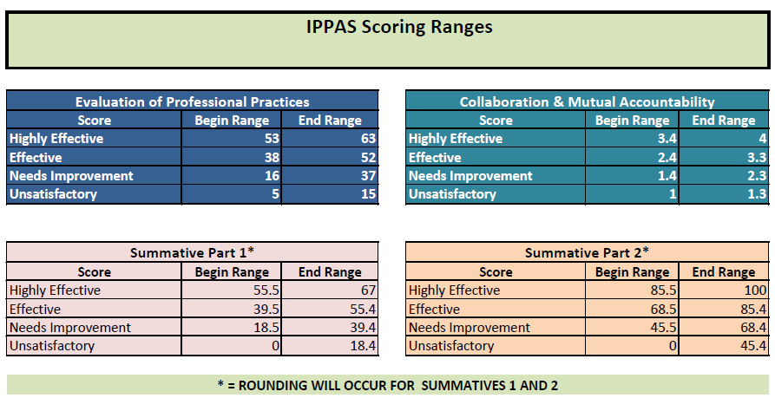
IPPAS Scoring Ranges
Categorical values for student achievement will be assigned a scaled number worth a total of 33 possible points (1/3 of the final evaluation)
Student achievement results will be added to Summative Part One results for a final Summative Part Two rating of HE, E, NI, or U
Summative Part Two Scores are used to determine performance pay for 2019-2020

Slide 23
Summative Evaluation Part Two:
Categorical values for student achievement will be assigned a scaled number worth a total of 33 possible points (1/3 of the final evaluation)
Student achievement results will be added to Summative Part One results for a final Summative Part Two rating of HE, E, NI, or U
Summative Part Two Scores are used to determine performance pay for 2019-2020

Slide 24
Summative Evaluation Part Two:
85.5 – 100 Highly Effective
68.5 – 85.4 Effective
45.5 – 68.4 Needs Improvement
0 – 45.4 Unsatisfactory

Slide 25
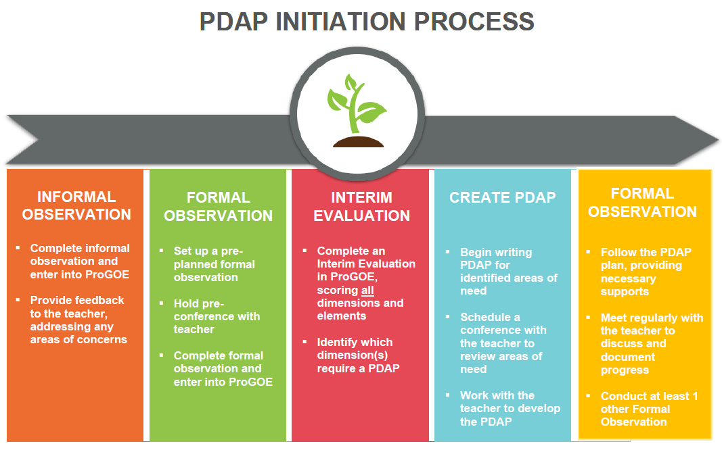

Slide 26
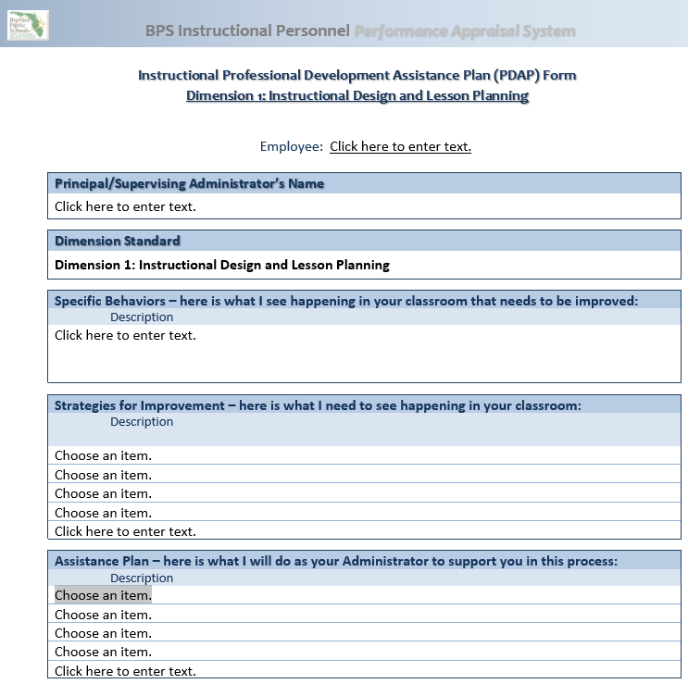
PDAP Form

Slide 27

BPS Mission Statement:
To serve every student with excellence as the standard.

